Slide 1
AGILE

Slide 2
AGILE PROCESS
Agile is a philosophy used to Rapidly Deploy the software in much more organised way.
It is a continuous iteration of project Development & Testing life cycle.
It is an iterative approach to project management and software development that helps teams deliver value to their customers faster.
Agile is an umbrella term for a set of methods and practices based on values and principles expressed in the Agile manifesto.

Slide 3
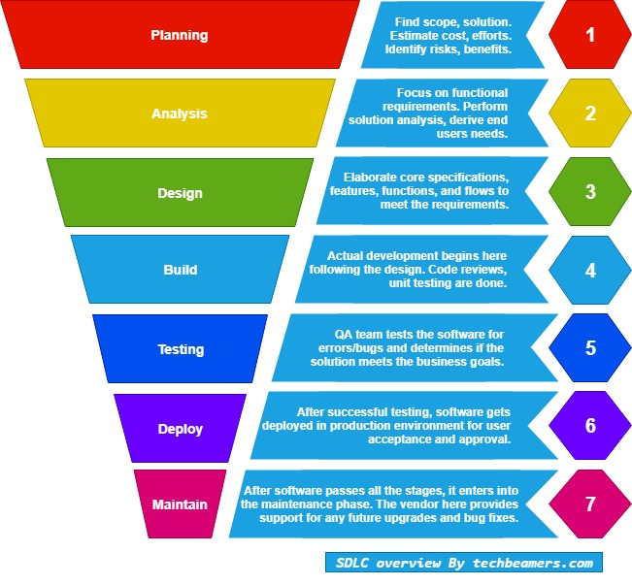
SDLC

Slide 4
Why Agile over Traditional SDLC?
Time Consuming
Unidirectional(Never Backward)
Monolithic Software
Difficulty in Responding Changes
Bulky Documentation
Little Room for Iterations
Failure of a single Dependency may ruin entire software.
Customer is not involved in Development & Testing activity.
Customer satisfaction is not a major goal.
Testing & Development activities are not parallel.
No Tracking activity for Testing & Development teams.
No Face to Face conversation between Development team , Testing team & Stake Holders.

Slide 5
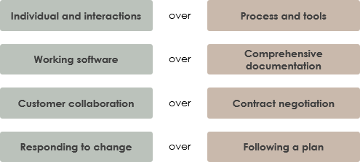
VALUES OF AGILE

Slide 6
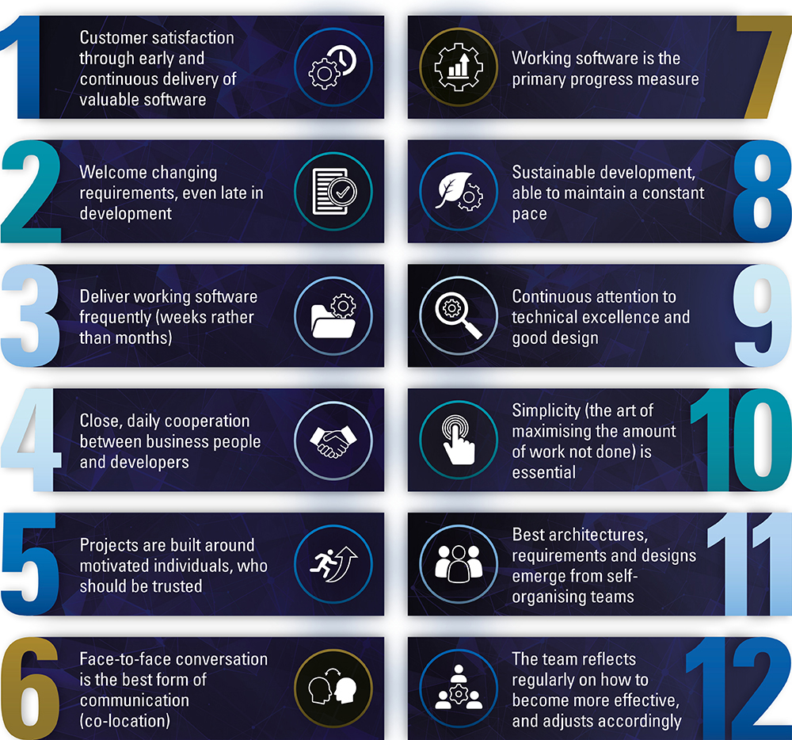
PRINCIPLES OF AGILE

Slide 7
Roles in Agile
Project Manager
Delivery Manager
Stake Holders
Product Owner
Scrum Master
Development Scrum Team
Testing Scrum Team
Cross Functional Team

Slide 8
Roles | Responsibility
Project Manager | Planning Procurement and Execution of a project. Budgeting & Risk Management
Delivery Manager | Maintain Deadlines & Manages Delivery Teams. Create Distribution Plans
Stake Holder | Someone who has an interest or is concerned with the outcome of the project. Customer representative who facilitates the requirement. Program manager and subject matter expert who acts as an advisor and decision maker for creating a release plan.

Slide 9
Roles | Responsibility
Product Owner | To represent the voice of the customer. Preparing and prioritizing Product Backlog Active role in iteration planning and release planning meetings.
Scrum Master | Estimate Plans for whole Software development project. Helps the team members in clarifying goals and actions . Tracking the Progress. Act as Safe guard for his team. Handles Daily stand up meetings. Helps the team member to follow agile practice so that they can meet their commitments. To work with organisation to track the progress and process of the company.

Slide 10
Roles | Responsibility
Development Scrum Team(DST) | Perform Sprint Execution. Groom the product backlog. Plan the sprint. Responsible for developing user stories based on the sprint backlog.
Testing Scrum Team(TST) | Preparing Documentation Write Test Scenarios Write ,Perform & Automate Test Cases Responsible for writing test case and execution of those test cases, to make sure the quality and deliver working software to UAT.
Cross Functional Team (CFT) | People from DST , TST will work here to provide a solution .

Slide 11
Agile Keywords
Sprint
User Stories
Tasks
Subtasks
Product Backlog
Sprint Backlog
Scrum
Story Point
Capacity
Velocity
Burn up chart
Burn Down chart

Slide 12
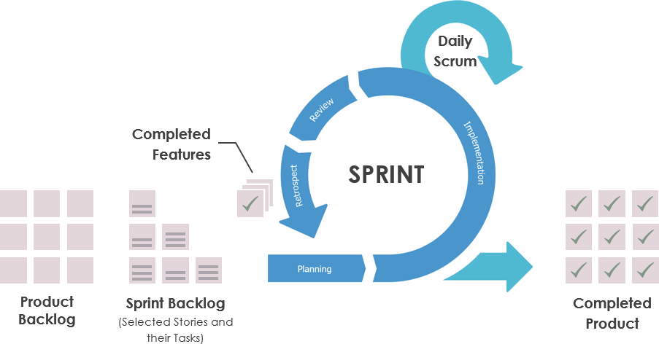
Sprint
It is a stipulated period within which the planned amount of work has to be completed by the team and made ready for review.

Slide 13
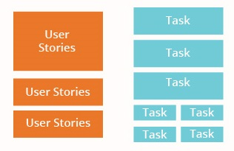
User Stories
It is the requirement that defines what is required by the end user as functionality.
Task
It Defines how a functionality to be implemented.
Subtask
Task can be further divided into sub task.
Subtask

Slide 14
Example of user stories and tasks
Tasks
Sub - Tasks
Account
Privacy
User Story
Security
Chats
WhatsApp Settings
2 step verification
Notification
Change no.
Data and storage usage
Request Acc info
Help
Delete my Account

Slide 15
Product Backlog
Product backlog is a Prioritized list of user stories that should be implemented as a part of a project.
Sprint Backlog
It is a List of the user stories/tasks which are to be worked upon in a particular sprint.
It is a sub set of Product Backlog.
Scrum
It is a daily meeting attended by scrum team to review progress and impediments(difficulties).

Slide 16
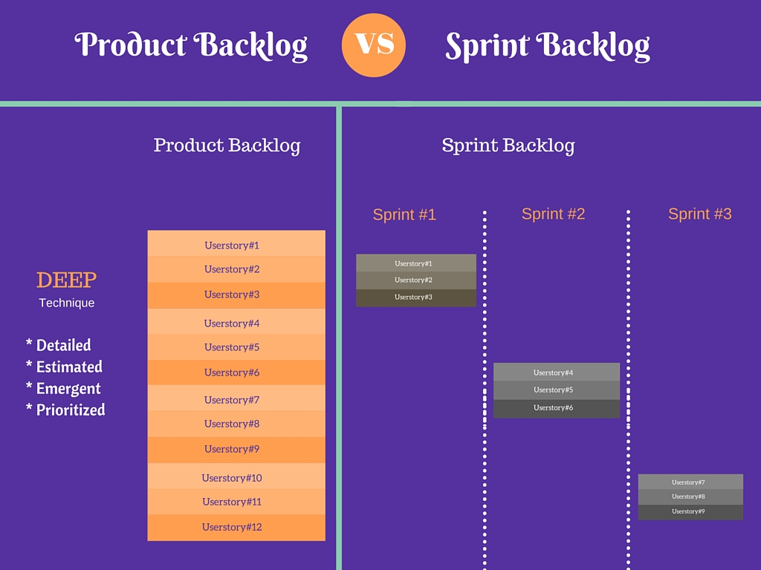
Product & Sprint Backlog

Slide 17
Example
Tasks
Sub - Tasks
Account
Privacy
User Story
Security
Sprint 1
Chats
WhatsApp Settings
2 step verification
Notification
Change no.
Data and storage usage
Request Acc info
Sprint 2
Help
Delete my Account

Slide 18
Story Point
A story point is a unit of measurement of the overall effort needed to complete specific requirements of PBIs.
Story point is number that tells the team about the difficulty level of the Story.
Difficulty level may include amount of work to do, complexity of work, any risk or uncertainty in doing the work.
Through a Story Point we can estimate Time reqd. To complete the user story.

Slide 19
Steps in Estimation of Story Point
Identification of Base Story.
Breakdown Base story into Tasks.
Allocating story points to tasks based on their complexity in terms of Fibonacci sequence.
Deriving the total amount of time(in days) required to complete the task.

Slide 20
Story Points- Fibonacci Sequence
Story Points | No. Of hrs
1 | 4-6
2 | 6-8
3 | 8-12
5 | 12-16
8 | 16-24
13 | 24-32
21 | 32-48

Slide 21
User Story Tasks Story Points Hours
Total story points = 56
Total no. of hours = 134
Total days required to complete tasks
= 134/8 = 17 days
COD
1
6
Payment methods
Net banking
21
48
Credit/Debit
21
48
UPI methods
13
32

Slide 22
Capacity
Capacity is how much an individual can commit.
Capacity is estimated in hrs.
How much time an individual can give for a task.
E.g. Committed work = 10 Test Cases/day
Velocity
How much amount of committed task an individual has completed .
Velocity is estimated in hrs.
How much time an individual has given for a task.
E.g. Completed work = 8 Test Cases /day
Efficiency= Velocity / Capacity.
= 8/10
=0.8

Slide 23
Capacity vs. Velocity

Slide 24
Burn Up & Burn Down
It is a visual presentation of Team’s work progress.
It displays Scope of the project and the work completed.
Burn up
A team can easily track their progress as they work towards completion of a sprint.
This charts shows how much work has been completed and total amount of work.
Burn down
It shows how much of work is remaining to be done in the project.

Slide 25
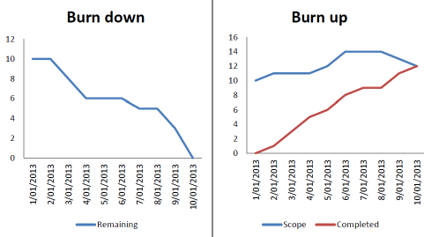

Slide 26
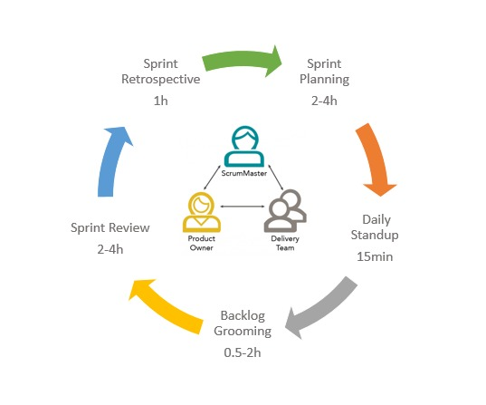
Agile Meetings

Slide 27
Sprint Planning Meeting
This is a first Sprint meeting which should be held at the very beginning of the Sprint.
Duration of meeting is 2-4 hours.
People Involved- Product Owner, Scrum Master & Team Members.
Goals-
Agree and verify about the PBIs that will be delivered in the Sprint.
Prioritisation of user stories.
Assign the PBIs/User Stories to team members.
Discuss initial plan for completing PBI.
Sprint Backlog is generated here.

Slide 28
Backlog Grooming Meeting
Before going to actual Sprint this meeting will be conducted.
The motto of the meet is just to have more clarity on PBIs.
Duration of meet will be less than 1 hr.
People Involved- Scrum Master & Scrum Team
Goals-
Breakdown User stories to Tasks and Tasks into Subtasks.
To estimate stories and assign story point.
Refining user stories that no longer appear relevant.
Creating new user stories that in response to newly discovered needs.

Slide 29
Daily Stand-up Meeting
It is a meeting which will be held on daily basis during the entire sprint.
Each Team Member will Answer the following 3 question
What did you do Yesterday?
What will you do today?
Are there any impediments(difficulties) in your way?
Duration 15-20 mins.
People involved Scrum Master ,Product Owner and Scrum Team.
It Provides visibility to team on any Delay or obstacles.

Slide 30
Sprint Review Meeting
A Sprint review, as the title implies, is held at the very end of the Sprint.
The development team will show the demos of their accomplished work, i.e. they will show exactly what they produced during the Sprint .
Duration of meet will be 2-4 hrs.
People Involved- Product owner, Scrum Master, Scrum Team, Client, Stake Holders.
Goals-
Explain what items have been "Done" and what has not been "Done.“
Demonstration of the functionality built during the Sprint.
Customer can change requirements.

Slide 31
Retrospective Meeting
This meeting is conducted after the Sprint Review & Prior to the next Sprint.
Duration of the meet around 1hr.
Goals-
To Discuss Openly what went well & what didn’t during the previous sprint.
Work together to find better ways to meet the project goals.
To address what the team can
Start doing
Stop doing
Continue doing.

Slide 32
HOW TO IMPLEMENT AGILE?
SCRUM
XP
KANBAN
LEAN
CRYSTAL

Slide 33
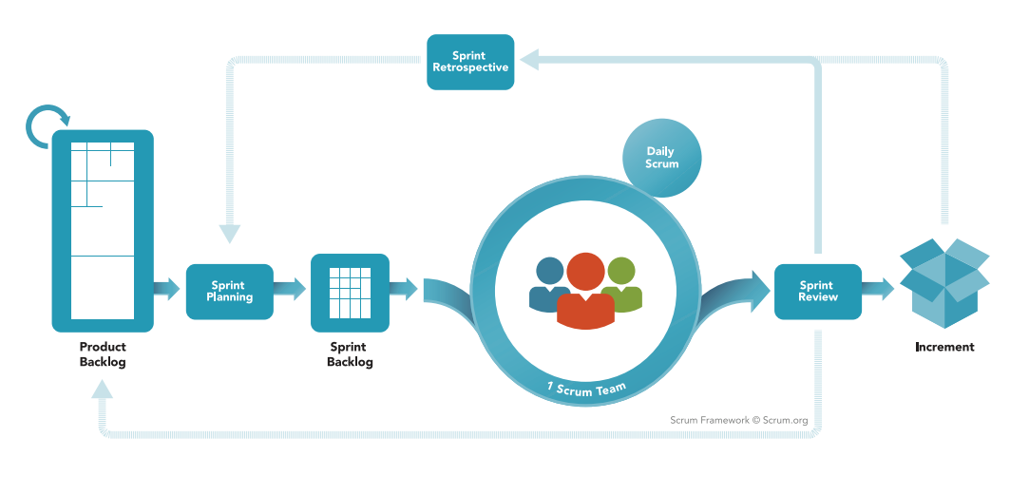
SCRUM FRAMEWORK
Requirement
Design
Coding
Testing
Deploy

Slide 34
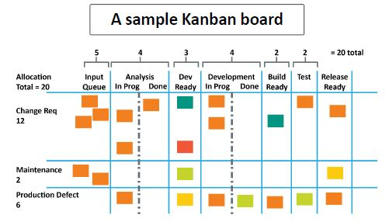
KANBAN

Slide 35
ADVANTAGES OF AGILE
Engagement of Stakeholder
Transparency
Frequent Delivery
Allow changes
Business Focus
Customer Focus
High Quality

Slide 36
OTHER WAYS TO IMPLEMENT AGILE
XP- Engineering Practices like TDD , Programming.
LEAN- Eliminate waste, Value Delivery
CRYSTAL-Reflective Improvement, Osmotic communication, Frequent Delivery

